Slide 1

AI Preventive Maintenance System
BY
2411EC010004 Akode Sandeep
2411EC010018 Emmadi Harshavardhan
2411EC010023 Gotrala Pranay
2411EC010030 Kalala Vikram
2411EC010034 R.Manjunath Goud
2411EC010043 Peddagolla Nagaraju
Under the Guidance of
Mrs B.Swetha
Department of ECE
School of Engineering
Malla Reddy University
Hyderabad, Telangana, INDIA

Slide 2
ABSTRACT
The AI Preventive Maintenance System is a low-cost hardware project designed to demonstrate real-time monitoring of motor health using ESP32 and MPU6050 vibration sensor. The system continuously tracks vibration changes, controls motor speed via potentiometer and L298N driver, and displays parameters such as temperature, humidity, motor speed, and vibration on an LCD and web dashboard. A buzzer provides immediate alerts when vibration exceeds critical thresholds. Logged data can be downloaded in CSV format for analysis. This project combines embedded systems, motor control, IoT dashboard development, and predictive maintenance concepts. It is intended for academic learning and industrial demonstration.

Slide 3
1. Introduction
1.1 Problem Definition & Description
Industrial machines can develop faults due to abnormal vibration, imbalance, loose
components, or changing operating conditions. Traditional maintenance may be performed
only after a failure or at fixed intervals, which can cause unexpected breakdowns, downtime,
and unnecessary maintenance. Continuous monitoring of machine vibration can help detect
abnormal conditions early. Therefore, a low-cost smart system is needed to monitor machine
health in real time and provide an early warning when vibration becomes abnormal.

Slide 4
1. Introduction
1.2 Objectives of the Project
Continuous vibration monitoring using MPU6050
Motor speed control via potentiometer and L298N driver
Real-time data processing with ESP32
Display of parameters on LCD and web dashboard
Buzzer alert on critical vibration
CSV logging for Excel/Google Sheets analysis

Slide 5
1. Introduction
1.3 Aim of the Project
To design and demonstrate a low-cost ESP32-based preventive maintenance system that continuously monitors vibration, detects abnormal conditions early, and provides real-time alerts and data logging.
Final year project demonstration
Industrial automation showcase
Predictive maintenance concept display
Excel-based data analysis

Slide 6
2. Methodology
Build Process
  Requirement Gathering: Identify motor monitoring needs and vibration thresholds.
  Design: Develop circuit connections and dashboard layout.
  Development: Program ESP32 for sensor data acquisition, motor control, and web server.
  Integration: Connect MPU6050, potentiometer, motor driver, LCD, and buzzer.
  Testing: Verify sensor readings, buzzer alerts, and CSV logging.
  Deployment: Demonstrate system with real-time dashboard and downloadable data.

Slide 7
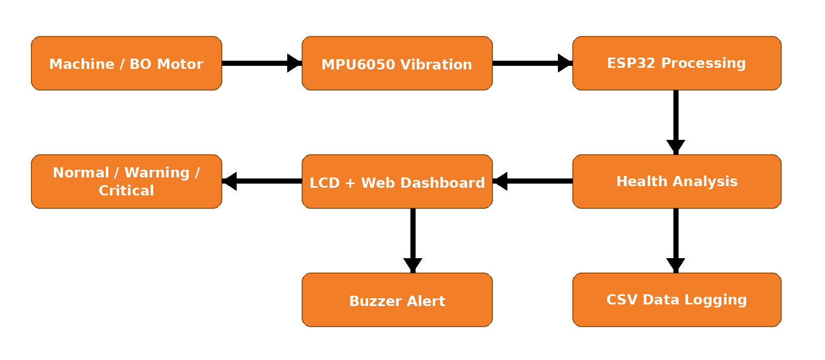
2.1 Methodology

Slide 8
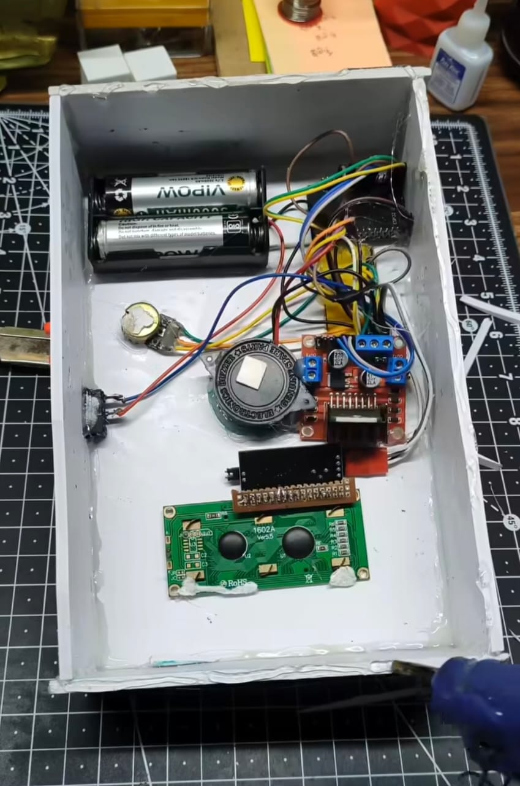
Hardware Setup
ESP32, motor driver, BO motor, sensor, LCD and supporting components
Hardware Setup

Slide 9
3. Requirements
3.1 Hardware Requirements
ESP32 DevKit
MPU6050 Sensor
Potentiometer
L298N Motor Driver
BO Motor
I2C LCD Display 16x2
Active Buzzer
Jumper Wires
Breadboard
USB Cable
External Motor Power Supply

Slide 10
3. Requirements
3.2 Software Requirements
Web Dashboard Features
• Live temperature
• Live humidity
• Motor speed
• Vibration value
• Machine status
• Health score
• Maintenance recommendation
• Vibration trend graph
There is also a separate page for downloading the machine data as a CSV file.
The CSV file can be opened directly in Excel or Google Sheets for further analysis.

Slide 11
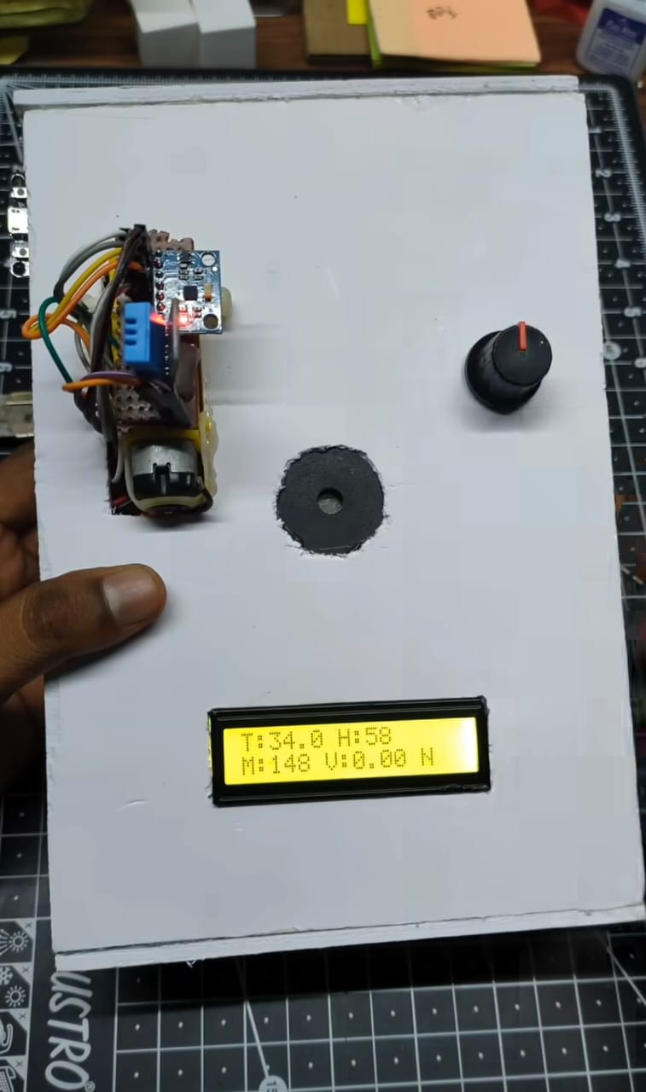
Project Prototype
AI Preventive Maintenance System – Physical Prototype
Project Prototype

Slide 12
4. System Analysis
4.1 Literature Survey
1. Sensor Reading
The MPU6050 is used to measure vibration changes from the machine body.
The vibration value is calculated from acceleration magnitude differences.
2. Motor Control
The potentiometer changes the PWM value sent to the L298N driver.
This changes the speed of the BO motor.

Slide 13
4. System Analysis
3. Health Monitoring
The system compares vibration values with predefined thresholds:
• Normal
• Warning
• Critical
If the vibration is too high, the system treats it as a maintenance alert.
4. LCD Output
The LCD continuously displays the most important machine values.

Slide 14
5. System Analysis
5.1 Existing System
Traditional machine maintenance generally uses reactive maintenance after a failure, preventive maintenance at fixed time intervals, and manual inspection by operators. These approaches may not provide continuous real-time information about machine health. Developing faults may remain unnoticed until they become serious, resulting in downtime and higher maintenance costs.

Slide 15
5. System Analysis
5.2 Existing System
Limitations Of Existing System :
➢Unexpected machine breakdowns
➢No continuous vibration monitoring
➢Manual machine inspection
➢Difficult to detect early abnormal conditions
➢Limited remote monitoring

Slide 16
5. System Analysis
5.3 Proposed System
Web Dashboard Features
The web server makes the project look more professional and industrial.
The dashboard shows live temperature, live humidity, motor speed, vibration value, machine status, health score, maintenance recommendation, and vibration trend graph.
There is also a separate page for downloading the machine data as a CSV file.

Slide 17
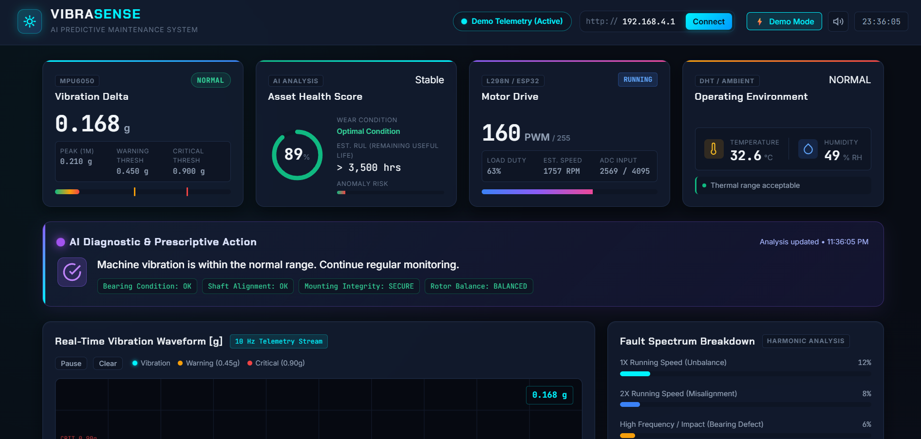
Web Dashboard
Real-time machine monitoring and predictive maintenance interface
Web Dashboard

Slide 18
5. System Analysis
5.3 Proposed System
Advantages of proposed system
✓ AI preventive maintenance system built successfully
✓ ESP32 reading machine vibration in real time
✓ BO motor speed controlled through potentiometer
✓ LCD showing live monitoring values
✓ Buzzer alert working on critical vibration
✓ Web dashboard working properly
✓ CSV download available for Excel analysis
This project is a strong example of combining embedded systems, industrial monitoring, and smart maintenance logic into one practical final-year project.

Slide 19
6. Testing and Result’s
Testing:
Verified MPU6050 sensor readings at different motor speeds
Checked LCD output for accuracy of parameters
Tested buzzer activation on critical vibration
Confirmed CSV logging and successful download
Validated web dashboard functionality
Results:
Sensor readings matched expected vibration values
LCD displayed parameters correctly in real time
Buzzer provided immediate alerts during abnormal vibration
CSV logs successfully analyzed in Excel/Google Sheets
Web dashboard provided smooth monitoring interface

Slide 20
Thank you

